Slide 1
ICE–4101: Artificial Intelligence Lecture # 2
Instructor: M. Shamim Kaiser
Email: m.shamimkaiser@juniv.edu
Text phone: 01511932323

Slide 2
Agent
An AI system is composed of an agent and its environment.
The agents act in their environment.

Slide 3
What are Agent and Environment?
An agent is anything that can perceive its environment through sensors and acts upon that environment through effectors.
A human agent has sensory organs such as eyes, ears, nose, tongue and skin parallel to the sensors, and other organs such as hands, legs, mouth, for effectors.
A robotic agent replaces cameras and infrared range finders for the sensors, and various motors and actuators for effectors.
A software agent has encoded bit strings as its programs and actions.

Slide 4
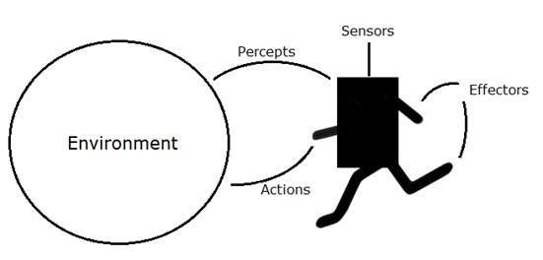
Sensor: Sensor is a device which detects the change in the environment and sends the information to other electronic devices.
Actuators: Actuators are the component of machines that converts energy into motion. The actuators are only responsible for moving and controlling a system. An actuator can be an electric motor, gears, rails, etc.
Effectors: Effectors are the devices which affect the environment. Effectors can be legs, wheels, arms, fingers, wings, fins, and display screen.

Slide 5
Agent Terminology
Performance Measure of Agent − It is the criteria, which determines how successful an agent is.
Behavior of Agent − It is the action that agent performs after any given sequence of percepts.
Percept − It is agent’s perceptual inputs at a given instance.
Percept Sequence − It is the history of all that an agent has perceived till date.
Agent Function − It is a map from the precept sequence to an action.

Slide 6
Examples of Agent:-
A software agent has Keystrokes, file contents, received network packages which act as sensors and displays on the screen, files, sent network packets acting as actuators.
A Human agent has eyes, ears, and other organs which act as sensors and hands, legs, mouth, and other body parts acting as actuators.
A Robotic agent has Cameras and infrared range finders which act as sensors and various motors acting as actuators.

Slide 7
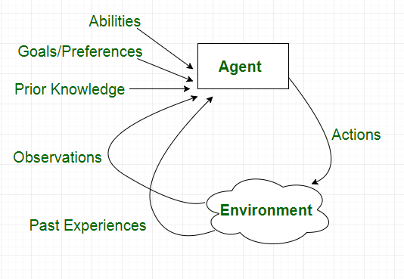
Agent

Slide 8
Intelligent Agents:
An intelligent agent is an autonomous entity which act upon an environment using sensors and actuators for achieving goals. An intelligent agent may learn from the environment to achieve their goals. A thermostat is an example of an intelligent agent.
Following are the main four rules for an AI agent:
Rule 1: An AI agent must have the ability to perceive the environment.
Rule 2: The observation must be used to make decisions.
Rule 3: Decision should result in an action.
Rule 4: The action taken by an AI agent must be a rational action.

Slide 9
Rational Agent:
A rational agent is an agent which has clear preference, models uncertainty, and acts in a way to maximize its performance measure with all possible actions.
A rational agent is said to perform the right things. AI is about creating rational agents to use for game theory and decision theory for various real-world scenarios.
For an AI agent, the rational action is most important because in AI reinforcement learning algorithm, for each best possible action, agent gets the positive reward and for each wrong action, an agent gets a negative reward.

Slide 10
Rationality
The rationality of an agent is measured by its performance measure.
Rationality can be judged on the basis of following points:
Performance measure which defines the success criterion.
Agent prior knowledge of its environment.
Best possible actions that an agent can perform.
The sequence of percepts.

Slide 11
PEAS Representation
PEAS is a type of model on which an AI agent works upon. When we define an AI agent or rational agent, then we can group its properties under PEAS representation model. It is made up of four words:
P: Performance measure
E: Environment
A: Actuators
S: Sensors
Here performance measure is the objective for the success of an agent's behavior.

Slide 12
PEAS for self-driving cars:
Let's suppose a self-driving car then PEAS representation will be:
Performance: Safety, time, legal drive, comfort
Environment: Roads, other vehicles, road signs, pedestrian
Actuators: Steering, accelerator, brake, signal, horn
Sensors: Camera, GPS, speedometer, odometer, accelerometer, sonar.

Slide 13
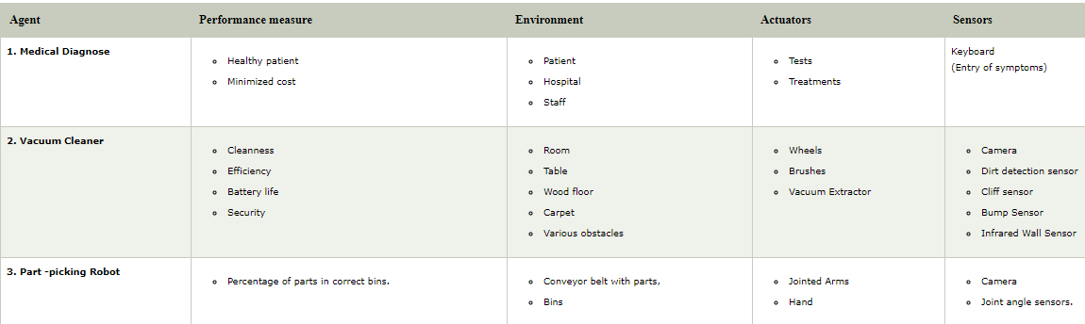

Slide 14
Types of Agents
Agents can be grouped into four classes based on their degree of perceived intelligence and capability :
Simple Reflex Agents
Model-Based Reflex Agents
Goal-Based Agents
Utility-Based Agents
Learning Agent

Slide 15
Agent Environment in AI
An environment is everything in the world which surrounds the agent, but it is not a part of an agent itself. An environment can be described as a situation in which an agent is present.
The environment is where agent lives, operate and provide the agent with something to sense and act upon it. An environment is mostly said to be non-feministic.

Slide 16
What is Ideal Rational Agent?
An ideal rational agent is the one, which is capable of doing expected actions to maximize its performance measure, on the basis of −
Its percept sequence
Its built-in knowledge base
Rationality of an agent depends on the following −
The performance measures, which determine the degree of success.
Agent’s Percept Sequence till now.
The agent’s prior knowledge about the environment.
The actions that the agent can carry out.

Slide 17
What is Ideal Rational Agent? (Cont.)
A rational agent always performs right action, where the right action means the action that causes the agent to be most successful in the given percept sequence. The problem the agent solves is characterized by Performance Measure, Environment, Actuators, and Sensors (PEAS).

Slide 18
A rational agent tries to “do the right thing” wrt a set of goals or utilities
The right thing can be specified by a performance measure defining a numerical value for any environment history
A rational action is whatever action maximises the expected value of the performance measure, given the current state of the environment and the percept sequence to date
But note that
Rational ≠ Omniscient (all knowing), Rational ≠ Clairvoyant (Tell anything), Rational ≠ Successful
It is entirely possible to do the right thing and to fail anyway
Sometimes randomness is the most rational choice! – e.g. games
An agent’s behaviour is specified by an agent function mapping perceptsequences to actions
The agent will usually also store knowledge or rules that help it to understand and to select actions • We will discuss four basic types of agents, in order of generality

Slide 19
The Structure of Intelligent Agents
Agent’s structure can be viewed as −
Agent = Architecture + Agent Program
Architecture = the machinery that an agent executes on.
Agent Program = an implementation of an agent function.

Slide 20
Simple Reflex Agents
The Simple reflex agents are the simplest agents. These agents take decisions on the basis of the current percepts and ignore the rest of the percept history.
They are rational only if a correct decision is made only on the basis of current precept.
Their environment is completely observable.
The Simple reflex agent works on Condition-action rule, which means it maps the current state to action. Such as a Room Cleaner agent, it works only if there is dirt in the room.

Slide 21
Simple Reflex Agents
Problems for the simple reflex agent design approach:
They have very limited intelligence
They do not have knowledge of non-perceptual parts of the current state
Mostly too big to generate and to store.
Not adaptive to changes in the environment.
For example, If temp>45 degree C then Switch on AC

Slide 22
Condition-Action Rule −
It is a rule that maps a state (condition) to an action.
Fully observable, that is, know about the environment
Example Self driving car

Slide 23
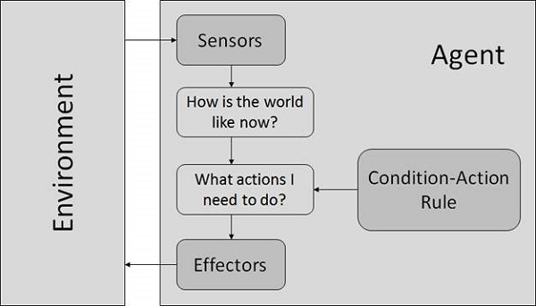

Slide 24
Model Based Reflex Agents
Model Based Reflex Agents use a model which choose their actions. They maintain an internal state.
Model − knowledge about “how the things happen in the world”.
Internal State − It is a representation of unobserved aspects of current state depending on percept history.
Updating the state requires the information about −
How the world evolves.
How the agent’s actions affect the world.

Slide 25
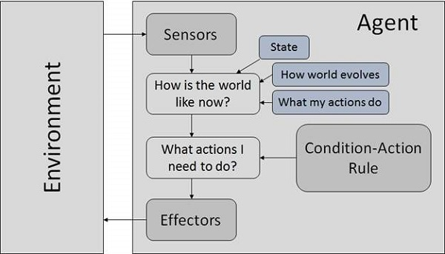
Model Based Reflex Agents
Self driving car-- Waymo's driverless car
(Cont..)

Slide 26
Goal Based Agents
They choose their actions in order to achieve goals. Goal-based approach is more flexible than reflex agent since the knowledge supporting a decision is explicitly modeled, thereby allowing for modifications.
Goal − It is the description of desirable situations.

Slide 27
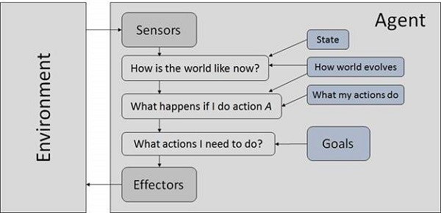

Slide 28
Utility Based Agents
Focus on Utility not good. There is an utility function.
They choose actions based on a preference (utility) for each state.
Goals are inadequate when −
There are conflicting goals, out of which only few can be achieved.
Goals have some uncertainty of being achieved and you need to weigh likelihood of success against the importance of a goal.
Deal with happy/unhappy state.

Slide 29
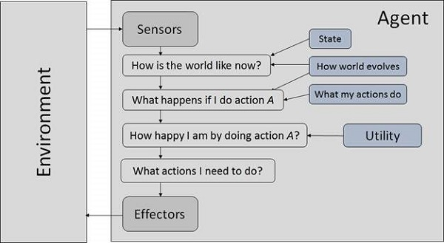

Slide 30

Re-Routing
You've been planning a road trip for a few weeks and the big day is finally here.
You get everyone loaded into the car, fire up the GPS and set off in the direction of your weekend adventure.
Two hours into your travel, you approach bumper to bumper traffic. It appears as though there might be a car accident up ahead.
Automatically, your GPS starts to look for a new route around the hazard, and you are able to exit the highway and navigate around the traffic pile-up.

Slide 31
It's a convenient feature some GPS programs have; they can not only help you get to your intended destination, but can do so in the shortest, fastest or safest way. It's also an example of the type of intelligent agent we're discussing in today's lesson.
Think about it this way: A goal-based agent (yes, another of the intelligent agents out there) makes decisions based simply on achieving a set goal. You want to travel from Los Angeles to San Diego, the goal-based agent will get you there. San Diego is the goal and this agent will map the right path to get you there. But, if you're traveling from Los Angeles to San Diego and encounter a closed road, the utility-based agent will kick into gear and analyze other routes to get you there, selecting the best option for maximum utility.

Slide 32
Properties of Environment
The environment has multifold properties −
Discrete / Continuous − If there are a limited number of distinct, clearly defined, states of the environment, the environment is discrete (For example, chess); otherwise it is continuous (For example, driving).
Observable / Partially Observable − If it is possible to determine the complete state of the environment at each time point from the percepts it is observable; otherwise it is only partially observable.
Static / Dynamic − If the environment does not change while an agent is acting, then it is static; otherwise it is dynamic.
Single agent / Multiple agents − The environment may contain other agents which may be of the same or different kind as that of the agent.
Accessible / Inaccessible − If the agent’s sensory apparatus can have access to the complete state of the environment, then the environment is accessible to that agent.

Slide 33
Learning Agents
A learning agent in AI is the type of agent which can learn from its past experiences, or it has learning capabilities.
It starts to act with basic knowledge and then able to act and adapt automatically through learning.
A learning agent has mainly four conceptual components, which are:
Learning element: It is responsible for making improvements by learning from environment
Critic: Learning element takes feedback from critic which describes that how well the agent is doing with respect to a fixed performance standard.
Performance element: It is responsible for selecting external action
Problem generator: This component is responsible for suggesting actions that will lead to new and informative experiences.
Hence, learning agents are able to learn, analyze performance, and look for new ways to improve the performance.

Slide 34
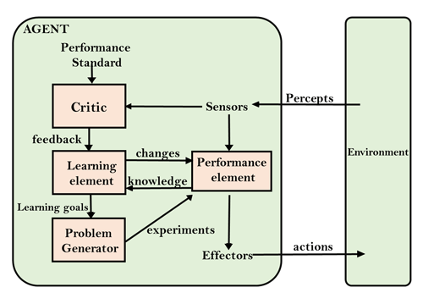

Slide 35
Deterministic / Non-deterministic − If the next state of the environment is completely determined by the current state and the actions of the agent, then the environment is deterministic; otherwise it is non-deterministic.
Episodic / Non-episodic − In an episodic environment, each episode consists of the agent perceiving and then acting. The quality of its action depends just on the episode itself. Subsequent episodes do not depend on the actions in the previous episodes. Episodic environments are much simpler because the agent does not need to think ahead.

Slide 36
AI Successes
Games: chess, checkers, poker, bridge, backgammon
Physical skills: driving a car, flying a plane or helicopter, vacuuming
Language: machine translation, speech recognition, character recognition
Vision: face recognition, face detection, digital photographic processing, motion tracking
Commerce and industry: page rank for searching, fraud detection, trading on financial markets

